Slide 1



High Standards vs. High Stakes in Sport
How OCD Hijack Performance and
How Treatment Restores It
CALI WERNER, PhD, LCSW, CMPC
  Athlete Rising, LLC
  OCD Institute of Texas
DINA NUNZIATO, PhD
  Chief Clinical Officer
  Anxiety Institute

Slide 2



Why This?
Notes:
Use the Increase List Level button in the Paragraph tab to change the color of the check mark. Use the Decrease List Level button to go back through the color sequence.
Dina to ask Cali - what led her to this work - conversational/ background story - drawing people in!

Slide 3
Stressors & Mental Health Concerns
Athletes Face Unique Stressors
PROTECTIVE
RISK
Performance
Pressure
Identity
Transition
Stigma
Injury
Financial Stress
Gap: Lack of integrated research across athlete types & interventions
(Brown, 2014; Gustafsson et al., 2017; Küttel & Larsen, 2020)

Slide 4
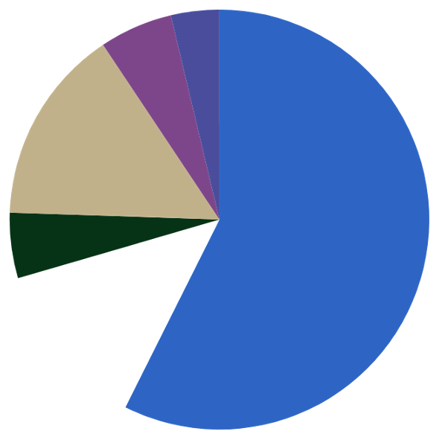
Results
Collegiate Athlete Survey
WHY A MAJOR PROBLEM?
I don’t want my teammates to know
6
Barriers to Seeking Help
I am not sure
15
I don’t believe I need help
57
Limited financial support
5
I feel like I am weak if I seek help
13

Slide 5
Article 2:
DASS-21 Scoring
Depression
Anxiety
Stress
SCORE | % OF ATHLETES
Normal 0-14 | 76% (n=98)
Mild 15-18 | 12.5% (n=16)
Moderate 19-25 | 6.7% (n=9)
Severe 26-33 | 2.9% (n=4)
Extremely Severe 34+ | 1.9% (n=2)
SCORE | % OF ATHLETES
Normal 0-7 | 75% (n=97)
Mild 8-9 | 9.6% (n=12)
Moderate 10-14 | 6.7% (n=9)
Severe 15-19 | 2.9% (n=4)
Extremely Severe 20+ | 5.8% (n=8)
SCORE | % OF ATHLETES
Normal 0-14 | 81.7% (n=105)
Mild 15-18 | 8.7% (n=11)
Moderate 19-25 | 7.7% (n=10)
Severe 26-33 | 1.0% (n=1)
Extremely Severe 34+ | 1.0% (n=1)
62% (n=80) never received prior mental-health support; 80% (n=103) not currently in treatment
(Henry & Crawford, 2005; Lovibond & Lovibond, 1995)
Notes:
Despite quite a few of the athletes meeting clinical levels for depression, anxiety, and stress - 80% were not in Tx.

Slide 6
Identity & Stress
=
Stress
Mental Health Struggle
  20 Olympian Interviews
Athlete identity
  80% of Olympians struggled
Notes:
Use the Increase List Level button in the Paragraph tab to change the color of the check mark. Use the Decrease List Level button to go back through the color sequence.

Slide 7
Olympic Athlete Interviews
“but I still pull my pants on one leg at a time and have poopy diapers to change at home. It doesn't change that.”
  “Maybe it was a bit of a blessing that I had an injury and stuff this year because... I was just so happy to make it and be there and be able to say I’m an Olympian at the end of the day.”
    “Be all in but not all consumed.”
      “I don't have any routine in my day anymore and I don't have any kind of this big purpose thing I had before, and soon people forget about what's happened and it will just be me.”
        “Trying to figure out what do I do with all of this energy... free time... what do I focus on now?”
“But I do feel like the toughest bit... is that you are an Olympian, right? So that’s great. But before that, I was *******, so I very much wanted to almost get rid of that part of being an Olympian.”
Notes:
Use the Increase List Level button in the Paragraph tab to change the color of the check mark. Use the Decrease List Level button to go back through the color sequence.
Part of my dissertation included interviewing 20 olympians on their struggle with the Post-Olympic Blues. We can discuss here - why identity/ full identity in one thing leads to heightened pressure/ anxiety.

Slide 8

OCD In Athletes
Over 5.2% prevalence rate of OCD in athletes (Cromer et al., 2017)
  General population (2.3%)
    Behavioral health no-show rates are cited as the highest of any specialty, driven by stigma, appointment anxiety, and the nature of the conditions being treated, and psychiatry in particular tends to run highewhichr because of long wait times between booking and appointment (6-8 weeks for psychiatry), allows life to intervene
(Dean & Rowan, 2014; Ryan et al., 2018)
Notes:
Use the Increase List Level button in the Paragraph tab to change the color of the check mark. Use the Decrease List Level button to go back through the color sequence.

Slide 9
Diagnosing OCD
DSM-V
Presence of Obsessions, Compulsions, or Both.
Defined by:
Recurrent thoughts, urges, or images that are experienced, at some time during the disturbance, as intrusive and unwanted, and that in most individuals cause marked anxiety and distress
  The individual attempts to ignore or suppress such thoughts, urges, or images, or to neutralize them with some other thought or action (i.e. by performing a compulsion)
Notes:
Use the Increase List Level button in the Paragraph tab to change the color of the check mark. Use the Decrease List Level button to go back through the color sequence.

Slide 10
Most Common Types of OCD
Contamination—Washing hands or cleaning uniform excessively.
  Sexual/harm obsessions—Did I just impulsively harm someone by my thought or action?
    Symmetry obsessions—Counting, tapping, in patterns with specific order.
      Magical thinking—If I don’t do this ritual, something bad will happen.
        Scrupulosity—Did I have a bad thoughts?
Health/somatic—Hyper-focus on health, body checking
  ”Just right” experience (Not Just Right Experience)—Doing something repeatedly until it “feels right”.
Notes:
Use the Increase List Level button in the Paragraph tab to change the color of the check mark. Use the Decrease List Level button to go back through the color sequence.

Slide 11
The OCD Cycle
Intrusive thought and distress
Maintenance of Symptoms
Compulsion
Clinical
Effectiveness
Reinforcement of Compulsion
Short-term reduction of distress

Slide 12
How Does OCD Function?
Anxiety Peaks/
Feels Intolerable
Mitigating
Behaviors
Anxiety Spikes
Mitigating
Behaviors
Anxiety Spikes
Mitigating behaviors reduce anxiety - but not down to baseline
Intrusive thought/anxiety provoking situation
Notes:
Use the Increase List Level button in the Paragraph tab to change the color of the check mark. Use the Decrease List Level button to go back through the color sequence.
With most types of anxiety, this can look like avoidance, ruminating, distraction, emotion suppression, etc
With OCD, it usually looks like rituals, but can also be avoidance, ruminating, etc.

Slide 13

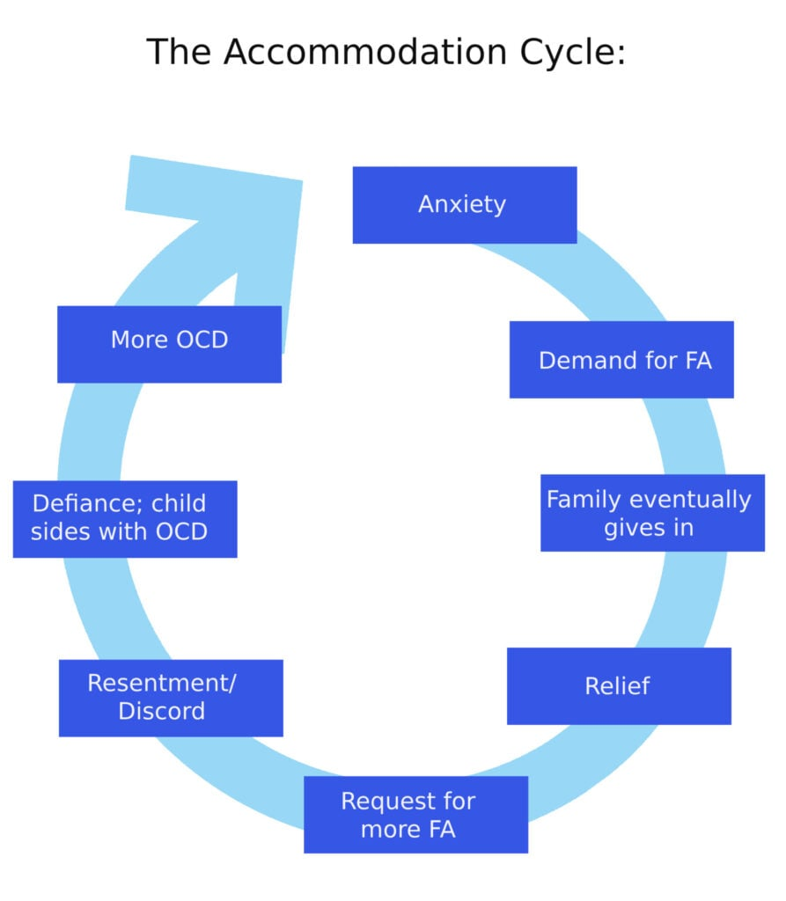
Assessing OCD
Yale-Brown Obsessive Compulsive Scale (YBOCS)
  CY-BOCS for children 17 and under
    Family Accommodation Scale (FAS)
Notes:
Use the Increase List Level button in the Paragraph tab to change the color of the check mark. Use the Decrease List Level button to go back through the color sequence.

Slide 14


Tendencies vs. OCD
Superstition
  Checking shoe to make sure it is tight 1x
  Listening to the same song before every game
  Wearing your lucky socks every game
      These superstitions take little to no time and are not considered distressing to individual
Compulsion
  Checking shoes more than one time and getting stuck waiting for a just-right feeling
  Feeling panic if interrupted listening to pre-competition song/ having to start it over
  Now have to wear same socks, use same shampoo, tap same door, high-five same teammate before every game
      The superstitions became excessive and time-consuming.
      It would be distressing if could not engage in the rituals

Slide 15
Type A vs. OCPD
Tendencies
  Organized
  Prepared
  On time
  Likes to keep lists
  May like to take lead on projects
  "put together" or "on top of it"
  Very reliable
      Team captain
OCPD
  Difficulty adjusting to change
  Has to be a certain way
  May struggle to have guests over
  Micro-manage
  Negatively impacting ability to function
  Over-rigidity with behaviors in sport
  Others "walking on eggshells"

Slide 16
The Perfectionism Paradox
The harder we try to eliminate mistakes, the more attention we give them.
  Perfectionism creates:
    Self-monitoring
    Desire to control uncontrollable
    Hesitation
    Muscle tension
    Fear of failure
    Attention narrowing
Notes:
Use the Increase List Level button in the Paragraph tab to change the color of the check mark. Use the Decrease List Level button to go back through the color sequence.

Slide 17

Adaptive Striving
Not all perfectionism is maladaptive.
  It is possible for athletes to be healthy strivers.
    Athletes may fear that giving up perfectionism means abandoning excellence entirely, but that is not the goal.
      It is possible for athletes to make striving for excellence work for them, not against them.
        The goal is to help athletes function in healthy environment, where they strive for excellence, rather than being trapped by perfectionism.
Notes:
Use the Increase List Level button in the Paragraph tab to change the color of the check mark. Use the Decrease List Level button to go back through the color sequence.

Slide 18
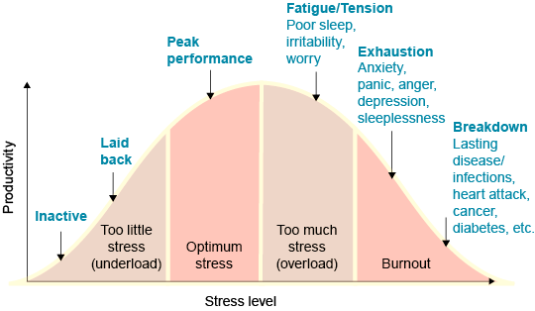
Adaptive Striving
Notes:
Use the Increase List Level button in the Paragraph tab to change the color of the check mark. Use the Decrease List Level button to go back through the color sequence.

Slide 19
The Pre-Performance Ritual
Rituals alone don’t cause burnout - anxiety does
For athletes w/ high anxiety = rituals more likely to become compulsive and detrimental
Coaches & Families
  Avoid maintaining messaging of rigid pre-performance routines for anxious athletes
  Pre-screen athletes for anxiety disorders per best NCAA practices (2016)
  Create ways for teammates and athlete support staff to debunk stigma to help athletes seek support
  Develop skills to distinguish performance anxiety from diagnosable anxiety disorder
Athletes
  Rigid routines may signal further anxiety
  Seek confidential mental health support (teammates view this as trustworthy, not weak)
  Educate yourself on anxiety signs
  Consider CBT/ ERP if rituals feel detrimental
(Werner et al., 2021)

Slide 20
Clinicians
Engage in ERP planning
“Do you have to do it?”
  “Can you tolerate not doing it?”
    Explain why overcorrecting for long term freedom may make sense
Pre-Performance Routines
Rituals
(Werner et al., 2021)
Notes:
Use the Increase List Level button in the Paragraph tab to change the color of the check mark. Use the Decrease List Level button to go back through the color sequence.

Slide 21
Natural Course Of An Emotion…
Peak of Emotion
Compulsion —Emotion is temporarily neutralized
Natural ebbing of emotion
Intrusive thought/anxiety provoking situation
Return to baseline
Notes:
Use the Increase List Level button in the Paragraph tab to change the color of the check mark. Use the Decrease List Level button to go back through the color sequence.

Slide 22
Erp Disrupts The Cycle
Peak of exposure
Use a
different shampoo
2x max to tie my shoes
Exposure
Exposure repeated
Exposure repeated
Not apologizing on way to start
Exposure repeated
Tapping 3x on purpose
Long term relief
Ritual
Exposure repeated
*temporary relief*
Building motivation is important
Notes:
Use the Increase List Level button in the Paragraph tab to change the color of the check mark. Use the Decrease List Level button to go back through the color sequence.
CW will explain specific case (of own personal OCD journey with running and what ERP looked like) to help participants understand the cycle

Slide 23
ERP + Values = Performance Freedom
OCD Says
  “Be 100% certain.”
  “There isn’t room for mistakes”
  “You can’t perform/ cope without the ritual.”
  Once you “fix” anxiety, then you can compete!
Performance with Purpose Says
  “Notice the thought.”
  “Teach your brain you can tolerate uncertainty.”
  “Compete with the anxiety!”
Notes:
Also will discuss burnout!

Slide 24
VS
MY VALUES
  Play aggressively
  Enjoy the process
  Make room for mistakes/ growth
  Give your full effort.
ANXIETY VALUES
  Play tentatively
  Playing with fear
  No room for mistakes. Low self-esteem.
  Don’t disappoint others.

Slide 25
Case Study -
Malcolm
A Division I baseball pitcher develops OCD after a series of poor performances. He believes he must complete his pre-pitch routine perfectly (adjust glove three times, tap the mound twice, exhale in a specific pattern) or something bad will happen. His rituals grow longer, his anxiety increases, and he struggles to stay mentally present during games.
Treatment Goals
Help the athlete perform with uncertainty rather than attempting to eliminate uncertainty.
  Confidence comes from learning: "I can play well even when anxiety is present."
Notes:
Use the Increase List Level button in the Paragraph tab to change the color of the check mark. Use the Decrease List Level button to go back through the color sequence.

Slide 26
ERP Examples for Malcolm
Easier Exposures
  Tie cleats 1x only
  Change warm-up order
  Tap mound 2x instead of 3x
  Use different water bottle
  Wear “unlucky” socks
Harder Exposures
  Walk onto field without checking equipment
  Skip an entire pre-game ritual
  Purposefully begin warm-up when not feeling ready
  Leave intrusive thought unanswered throughout practice
  Compete without correcting routine after mistake

Slide 27
Response Prevention is Essential
“What message am I sending to the brain?”
Instead of:
  Restarting the routine
  Seeking reassurance from coaches
  Mentally reviewing
  Trying to “feel ready”
  Telling myself “it will be okay”
Practice:
  Noticing the urge
  Allowing the uncertainty
  Redirecting attention back to the next pitch/ play
ERP is not about helping athletes feel ready → it is about helping them perform effectively without needing certainty first.

Slide 28
What Now?
Keep anxiety
In the healthy adrenaline ready zone by...
Building a tolerance for uncertainty provides freedom
Recognizing that you care about your sport
which is causing stress
that OCD tries to use as fuel.
Teach the brain to lean in instead.
*inhibitory learning*

Slide 29
Levels Of Care
Outpatient
  45-50 minute sessions 1-2x per week
IOP
  3-8 hours per week
PHP
  Around 20 hours per week
  Includes psychiatry and FT
Residential
  7 days a week
  Includes psychiatry and FT
Inpatient
  Short-term stabilization
Notes:
I always like to include why it is important not to rule out ERP as ineffective before determining things like... are they using response prevention, is this the right level of care, etc. But we can keep or take out this slide if it feels out of place.

Slide 30

@CaliWerner1
Cali@HoustonOCD.org
DNunziato@anxietyinstitute.com

Slide 31
References
Cromer, L., Kaier, E., Davis, J., Stunk, K., & Stewart, S. E. (2017). OCD in college athletes. American Journal of Psychiatry, 174(6), 595−597.
  Dean, C., & Rowan, D. (2014). The social worker's role in serving vulnerable athletes. Journal of Social Work Practice, 28(2), 219-227.
    Henry, J. D., & Crawford, J. R. (2005). The short‐form version of the Depression Anxiety Stress Scales (DASS-21): Construct validity and normative data in a large non-clinical sample. British Journal of Clinical Psychology, 44(2), 227–239. https://doi.org/10.1348/014466505X29657
      Lovibond, S. H., & Lovibond, P. F. (1995). Manual for the Depression Anxiety Stress Scales (2nd ed.). Psychology Foundation of Australia.
        Ryan, H., Gayles, J. G., & Bell, L. (2018). Student-athletes and mental health experiences. New Directions for Student Services, 2018(163), 67–79. https://doi.org/10.1002/ss.20271
Werner, C., Waite, L., Turner, K., Storch, E. A., Björgvinsson, T., McIngvale, E. (2021) The Pre-Performance Ritual: A Recipe for Success or a Path to Burnout? Journal of Issues in Intercollegiate Athletics, 2333-1577.
Notes:
Use the Increase List Level button in the Paragraph tab to change the color of the check mark. Use the Decrease List Level button to go back through the color sequence.

